Slide 1






Chapter - 2.3
Data Literacy & Analysis

Slide 2

Disclaimer
The content is curated from online/offline resources and used for educational purpose only

Slide 3

Chapters for Discussion
Python Basics for Data Science
OOPs Concept
Data Literacy & Analysis

Slide 4

Chapter 2.3

Slide 5

Learning Objective
You will learn in this Chapter:
Retrieve data from multiple sources
Perform Exploratory Data Analysis
Handle categorical and ordinal features
Will get practical exposure to data analysis tools like NumPy, Matplotlib,and Pandas.

Slide 6

Learning Outcome
You will learn in this Chapter:
Retrieve and integrate data from multiple sources for analysis.
Perform Exploratory Data Analysis (EDA) to identify patterns, trends, and anomalies in datasets.
Effectively handle categorical and ordinal features during data preprocessing.
Gain practical exposure to widely used data analysis libraries such as NumPy, Matplotlib, and Pandas for manipulating and visualizing data.

Slide 7
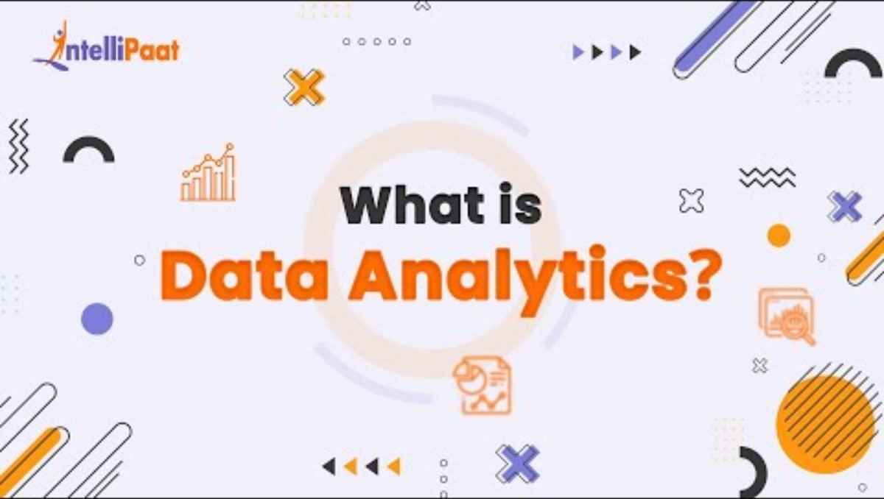
Importance of Data Analysis
Source :
https://www.youtube.com/watch?v=37x5dKW-X5U
Notes:
Let's try to understand the importance of data analysis from this video.

Slide 8

What is Data Analytics?
Data analytics is the systematic computational analysis of data to extract meaningful insights, identify patterns, and support decision-making.
It involves various processes such as data collection, cleaning, transformation, analysis, and visualization.
The goal is to derive useful information from data that can help in making informed business decisions, improving processes, and predicting future trends.
Source :
https://miro.medium.com/v2/resize:fit:720/format:webp/0*cmWRXafuUmoOQrlq.gif
Notes:
For understanding the what is Data Analytics ?
Here given the Inventory management example below
---------------------------------------------------------------------------
Business Problem
A large retail chain is struggling with inventory management across its stores. They face issues such as overstocking, leading to increased holding costs, and stockouts, causing lost sales and dissatisfied customers. The management wants to optimize inventory levels to ensure that each store has the right amount of stock, reducing costs while meeting customer demand.
Objectives
Reduce inventory holding costs.
Minimize stockouts and lost sales.
Improve overall customer satisfaction by ensuring product availability.
DA Process:
Data Collection
Data Cleaning and Transformation
Data Analysis
Data Visualization
Implementation and Monitoring
Outcome and Benefits
Cost Reduction: Significant reduction in inventory holding costs due to optimized stock levels.
Sales Increase: Decrease in lost sales due to fewer stockouts, leading to higher revenue.
Improved Supplier Relationships: Better management of supplier performance and more reliable restocking processes.
Customer Satisfaction: Enhanced customer experience due to better product availability and reduced instances of stockouts.
By leveraging data analytics, the retail chain can effectively address its inventory management challenges. The data-driven approach enables the company to optimize stock levels, reduce costs, improve sales, and enhance customer satisfaction, ultimately leading to a more efficient and profitable business operation.

Slide 9




Types of Data Analytics
Descriptive Analytics
Diagnostic Analytics
Predictive Analytics
Prescriptive Analytics
Notes:
Descriptive Analytics
The simplest type of analytics is descriptive analytics, which serves as the base for all other types.
It enables you to quickly summarise what occurred or is happening by drawing trends from the raw data.
When used in business, it gives the analyst a view of important metrics and measurements used by the company.
Diagnostic Analytics
This type compares concurrent trends or movements, reveals correlations between variables, and, when possible, establishes causal relationships.
The question of why something happened can now be answered by comparing historical data to other data.
Diagnostic analytics offers in-depth perceptions into a specific issue.
Predictive Analytics
The use of predictive analytics provides an answer to the question, "What might happen in the future?" by making predictions about present trends or events.
It makes use of the outcomes of descriptive and diagnostic analytics to find clusters and exceptions as well as make predictions about future trends.
Prescriptive Analytics
Prescriptive analytics assists in providing recommendations for action.
Prescriptive analytics helps by making suggestions for taking action.
Prescriptive analytics is a type of advanced analytics that offers many benefits, such as sophisticated analysis based on deep learning or machine learning.

Slide 10
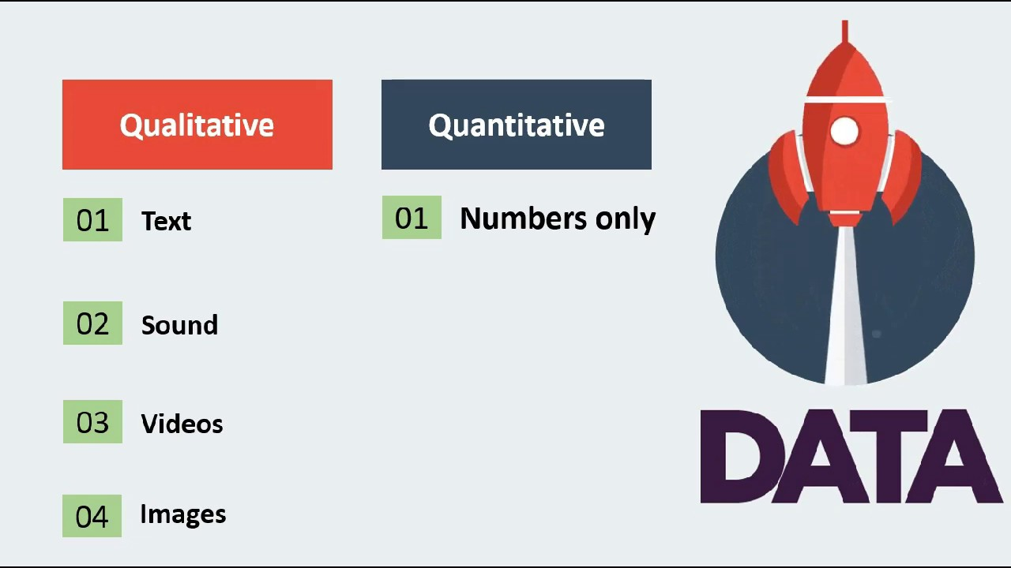
Types of Data
“Artificial intelligence is your rocket ship and data is the fuel.”- Michael Dell (founder of Dell Technologies)
Data Types in AI
Numeric Data. Numeric data is any data that can be represented in numerical form.
Categorical Data. Categorical data is a type of data that is used to group observations into distinct categories.
Image Data
Text Data
Time Series Data
Audio Data
Sensor Data
Source :
Image: Types of data
Notes:
Types of Data:
Now let's have a look at the types of data which are required to do these machine learning algorithms.
… Actually why do we need these data? Anybody. I need an answer from you...
OK the data is something that, a kind of experience that we are providing to the machine or computer. I hope you have seen that in the machine learning definition. The machine is going to be trained or learned by using the experience right, that experience is nothing but a data. So this data can be in many forms.
That you can see in the slide that, the data can be a numerical data, categorical data, image data, text data, time series data, and it can be audio and the sensor data also.
We can use all these kind of data in artificial intelligence and it depends upon the specific task. That means every data is having its own importance for the respective machine learning or artificial intelligence application.
In the coming slides, I will be briefing you about some of these data how we are using in the AI applications.

Slide 11
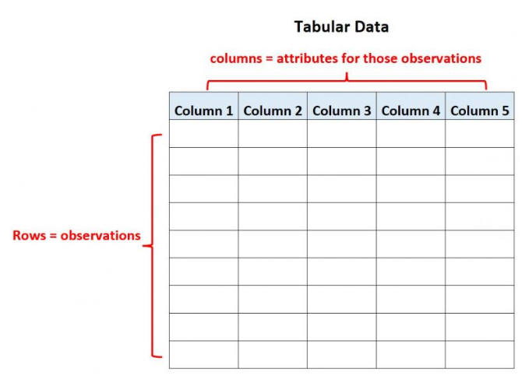
Types of Data
Tabular Data
Structured data.
Formats: CSV(Comma-Separated Values) files, Excel spreadsheets, or relational databases.
Row represents an individual instance or observation, Column corresponds to a specific attribute or feature.
Tabular data
Notes:
Now let's have a look at the tabular data, it's the most common data that we are looking every time. and these data is very important for us to perform the machine learning applications.
Tabular Data
Structured data that is organized in rows and columns, similar to a table. It is commonly represented in formats such as CSV (Comma-Separated Values) files, Excel spreadsheets, or relational databases.
Each row in the table represents an individual instance or observation, while each column corresponds to a specific attribute or feature.
Example:
At school, several data tables would have been familiar to you on a daily basis. Your timetable, multiplication tables, and vocabulary lists are all examples of what we call tabular data.

Slide 12
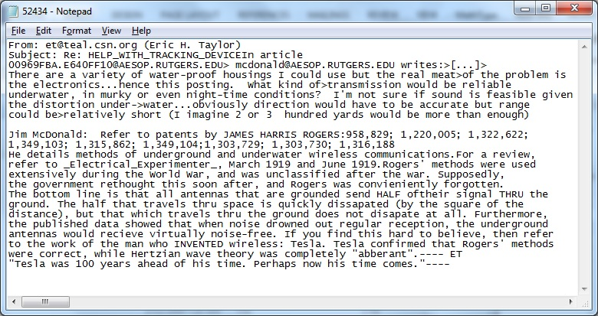
Types of Data:
Text Data
Data is made up of words and sentences.
For sentiment analysis and text classification.
Include speech transcripts, emails, articles, social media posts, customer reviews, and other forms of unstructured text.
Trained using natural language processing (NLP) algorithms to analyse text and extract relevant information from it.
Unstructured. in nature
Source :
Text data
Notes:
Text data is a kind of unstructured data that is very important for us to work on the natural language applications.
Text Data
Another very common form off data used in AI is text data.
Text data can we define as data made up of words and sentences. Nowadays text data is used for tasks such as sentiment analysis and text classification.
The text data also Include speech transcripts, emails, articles, social media posts, customer reviews, and other forms of unstructured text.
AI models are trained using natural language processing (NLP) algorithms to analyse text and extract relevant information from it.
For Example, Any organization wants to recognise reviews of any product whether users review are positive or negative for that product or service
AI can be used to classify emails into categories, detect sentiment in customer reviews, or generate content from a given set of keywords.
Unlike tabular data, text is an unstructured way of recording information

Slide 13

Types of Data
Visual Data
Any form of data that is represented visually, such as images, videos, or graphical representations.
Moderation is needed for image and video data
Image moderation : unsuitable or harmful object detection, such as weapons, drug paraphernalia and excessive/gratuitous nudity, etc.
Video moderation uses the same technologies, analysing the video frame by frame for offending visuals.
CIFAR Dataset
Notes:
Most of the computer vision applications and deep learning applications work on the image data only.
Visual Data
Visual data can be defined as any form of data that is represented visually, such as images, videos, or graphical representations.
visual data used in computer vision, image recognition, object detection, video analysis, and other related applications.
Data for image and video moderation is also essential to make these platforms safe environments, free from abusive contents.
Image moderation utilizes object detection by analysing the media for items that may be unsuitable or harmful, such as weapons, drug paraphernalia and excessive/gratuitous nudity, etc.
Video moderation uses the same technologies, analysing the video frame by frame for offending visuals.

Slide 14
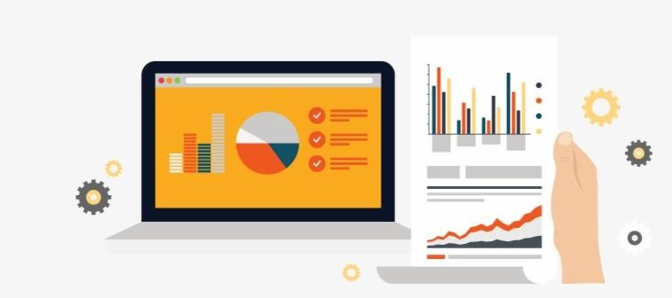
What is EDA?
Technically, The primary motive of EDA is to
Examine the data distribution
Handling missing values of the dataset
Handling the outliers
Removing duplicate data
Encoding the categorical variables
Normalizing and Scaling
Source :
https://www.seekpng.com/ipng/u2w7y3r5a9y3u2a9_data-analytics-exploratory-data-analysis-icon/
Notes:
Hello everyone, today we're going to dive into the concept of Exploratory Data Analysis, or EDA for short. EDA is a crucial step in the data analysis process, allowing us to understand the underlying patterns and characteristics of our data before we move on to more complex modeling and analysis.
Technically, the primary motive of EDA is multifaceted. First and foremost, it helps us to examine the data distribution. By understanding how our data is spread out, we can make more informed decisions about the types of analyses that are appropriate.
Next, EDA involves handling missing values in the dataset. Missing data can skew our results, so it's important to identify and address any gaps we find.
Another critical aspect of EDA is handling outliers. Outliers are data points that differ significantly from other observations and can have a disproportionate impact on our analysis. Identifying and deciding how to handle these outliers is a key step in ensuring the accuracy of our results.
We also need to consider duplicate data. Removing duplicates is essential because repeated data points can bias our analysis and lead to incorrect conclusions.
Additionally, encoding categorical variables is a necessary step in EDA. Many machine learning algorithms require numerical input, so we need to convert categorical data into a format that can be processed.
Finally, normalizing and scaling our data is important. This step ensures that our data is on a similar scale, which can improve the performance of many algorithms.
By systematically addressing these tasks, EDA helps us to clean and prepare our data, making it ready for more advanced analysis and modeling."

Slide 15
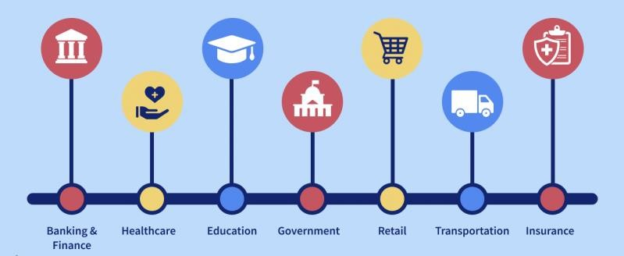
Importance of EDA
Source :
https://www.interviewbit.com/blog/applications-of-big-data/
Notes:
EDA serves as the foundation for any data analysis project. By exploring and understanding the data upfront, we can uncover initial insights that guide the entire analytical process.
let's explore some of its practical applications across various domains.
Business Intelligence and Decision-Making: EDA helps businesses analyze sales data, customer feedback, and market trends. By understanding these data patterns, companies can make informed decisions about product development, marketing strategies, and customer service improvements.
Healthcare Analytics: In healthcare, EDA is used to analyze patient data, identify trends in disease prevalence, and evaluate the effectiveness of treatments. This analysis can lead to improved patient outcomes and more efficient healthcare delivery.
Finance and Risk Management: Financial institutions use EDA to assess risk, detect fraud, and optimize investment strategies. By exploring historical financial data, analysts can identify patterns that indicate potential risks or opportunities.
Marketing Analysis: EDA allows marketers to analyze campaign performance, understand customer behavior, and segment target audiences. This insight helps in designing more effective marketing campaigns and improving customer engagement.
Retail and E-commerce: In retail, EDA is used to analyze sales data, inventory levels, and customer purchase patterns. This helps retailers optimize inventory management, pricing strategies, and promotional activities.
Social Media Analysis: EDA helps in analyzing social media data to understand user engagement, sentiment, and trends. Businesses and researchers can use these insights to enhance their social media strategies and monitor brand reputation.
Manufacturing and Quality Control: In manufacturing, EDA is used to analyze production data, monitor equipment performance, and detect defects. This helps improve product quality, reduce downtime, and enhance operational efficiency.
Sports Analytics: EDA is applied in sports to analyze player performance, game statistics, and injury patterns. Teams and coaches use these insights to develop strategies, enhance training programs, and make data-driven decisions.
Environmental Studies: Researchers use EDA to analyze environmental data, such as climate patterns, pollution levels, and biodiversity metrics. This helps in understanding ecological changes and developing strategies for conservation and sustainability.
Education Analytics: In education, EDA is used to analyze student performance data, identify factors affecting learning outcomes, and develop personalized learning plans. This helps in improving educational strategies and student success rates.
In summary, EDA is a versatile tool that can be applied in numerous fields to uncover valuable insights, inform decision-making, and drive improvements. Its ability to provide a comprehensive understanding of data makes it indispensable in today's data-driven world."

Slide 16
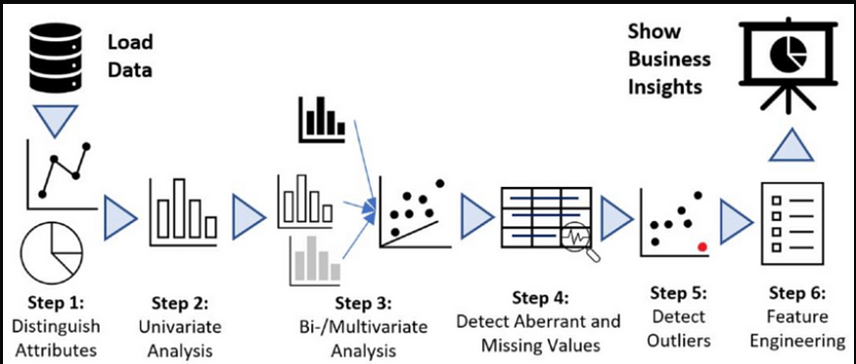
A Typical EDA Process
Source :
https://medium.com/@subhransunayak726/exploratory-data-analysis-eda-in-python-the-complete-guide-9d940cdf58d7
Notes:
Let's walk through a typical Exploratory Data Analysis (EDA) process. Understanding the steps involved will help us systematically explore and prepare our data for further analysis.
Data Collection and Loading: The first step is to collect and load the data. This could involve importing data from various sources such as databases, spreadsheets, or web APIs. Ensuring the data is in a usable format is crucial at this stage.
Initial Data Inspection: Once the data is loaded, we perform an initial inspection to understand its structure. This involves looking at the data types, number of rows and columns, and getting a general sense of the content. Common commands in programming languages like Python include head(), info(), and describe().
Data Cleaning: The next step is data cleaning. This involves handling missing values, removing duplicate records, and correcting any inconsistencies. Techniques such as imputation, deletion, or substitution can be used to manage missing data.
Data Transformation: After cleaning, we transform the data as needed. This might include encoding categorical variables into numerical values, normalizing or scaling features, and creating new variables through feature engineering. These transformations help prepare the data for analysis and modeling.
Exploratory Visualization: Visualization is a powerful tool in EDA. We create various plots such as histograms, box plots, scatter plots, and correlation matrices to visualize the data distribution, identify patterns, and detect outliers. Libraries like Matplotlib, Seaborn, and Plotly are commonly used for this purpose.
Summary Statistics: Calculating summary statistics helps us understand the central tendency, dispersion, and shape of the data distribution. Key metrics include mean, median, mode, standard deviation, and percentiles. These statistics provide a numerical summary of the data.
Outlier Detection and Handling: Identifying and handling outliers is crucial as they can significantly affect our analysis. Outliers can be visualized using box plots or scatter plots, and handled through techniques such as capping, transformation, or removal.
Bivariate and Multivariate Analysis: In this step, we explore the relationships between variables. Bivariate analysis examines the relationship between two variables using techniques like correlation analysis and scatter plots. Multivariate analysis looks at interactions between multiple variables using techniques like pair plots and heatmaps.
Hypothesis Generation: Based on the insights gained from the exploratory analysis, we generate hypotheses about the data. These hypotheses guide further analysis and modeling efforts. For example, we might hypothesize that a certain feature significantly impacts the target variable.
Documentation and Reporting: Finally, we document our findings and create reports or dashboards to communicate the insights. Clear documentation and visualizations help stakeholders understand the data and the conclusions drawn from the analysis.
In summary, a typical EDA process involves a series of systematic steps aimed at thoroughly understanding and preparing the data. This process ensures that we have a clean, well-understood dataset ready for more advanced analysis and modeling."

Slide 17

Activity Time: Consider the problem and discuss about Data Analysis steps involved
Scenario: Employee Data Analysis
Question: You have access to a dataset of employee information, including EmployeeID, Department, Salary, and YearsAtCompany. Explain the EDA process you would undertake to understand this data.
Notes:
Solution: Employee Data Analysis
Step 1: Understanding the Data
Familiarize with the Dataset: Begin by examining the structure of the dataset, understanding the meaning of each column (EmployeeID, Department, Salary, YearsAtCompany), and identifying the data types (e.g., numerical, categorical).
Step 2: Data Cleaning
Identify and Handle Missing Values: Check for missing values in the dataset. For Salary and YearsAtCompany, consider using imputation methods such as filling with the mean or median values. For Department, missing values could be imputed using the mode (most frequent value) or domain knowledge.
Remove Duplicates: Ensure there are no duplicate rows in the dataset, especially for unique identifiers like EmployeeID.
Step 3: Descriptive Statistics
Calculate Basic Statistics: Compute summary statistics such as mean, median, minimum, maximum, and standard deviation for Salary and YearsAtCompany. This provides a basic understanding of the central tendency and spread of the data.
Step 4: Data Visualization
Salary Distribution: Create histograms or box plots to visualize the distribution of salaries across the entire dataset. This helps in identifying the spread and any potential outliers.
Department-wise Salary Distribution: Use box plots to compare salary distributions across different departments. This can highlight disparities or variances in salaries among departments.
Years at Company: Plot histograms or bar charts to visualize the distribution of years employees have been at the company. This can reveal trends in employee retention and tenure.
Correlation Analysis: Generate scatter plots to explore the relationship between Salary and YearsAtCompany. Calculate the correlation coefficient to quantify the strength of this relationship.
Step 5: Insights and Reporting
Interpret Findings: Summarize the insights gained from the descriptive statistics and visualizations. For example, identify which departments have higher average salaries, detect any patterns related to employee tenure and salary, and note any significant outliers.
Prepare a Report: Compile the findings into a comprehensive report. Include visualizations and key statistics, and provide interpretations and recommendations based on the analysis. For instance, suggest addressing any detected salary disparities or developing strategies for improving employee retention.

Slide 18
EDA Techniques
EDA
Quantitative Technique
Graphical
Notes:
Now, let's explore the two main categories of techniques used in Exploratory Data Analysis (EDA): Quantitative and Graphical techniques. Each plays a crucial role in understanding and interpreting our data.

Slide 19
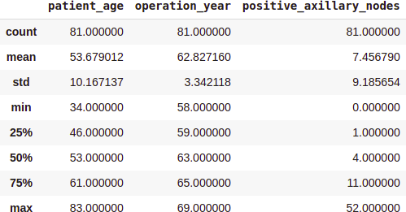
EDA: Quantitative Technique
Quantitative techniques in Exploratory Data Analysis (EDA) involve using statistical measures and methods to gain insights into data distribution, relationships, and patterns.
Source :
https://www.analyticsvidhya.com/blog/2021/08/exploratory-data-analysis-and-visualization-techniques-in-data-science/
Notes:
Quantitative Techniques:
Quantitative techniques involve numerical and statistical methods to summarize and describe the main features of a dataset.
Summary Statistics: Summary statistics provide a quick overview of the dataset's key characteristics. Common metrics include:
Mean: The average value of the data.
Median: The middle value when the data is ordered.
Mode: The most frequently occurring value.
Standard Deviation: Measures the dispersion or spread of the data.
Variance: The average squared deviation from the mean.
Percentiles: Values below which a certain percentage of the data falls.
Correlation Analysis: This technique measures the relationship between two numerical variables. The Pearson correlation coefficient is often used to quantify linear relationships, with values ranging from -1 (perfect negative correlation) to +1 (perfect positive correlation).
Hypothesis Testing: Statistical tests such as the t-test, chi-square test, and ANOVA help determine if there are significant differences between groups or relationships between variables.
Distribution Analysis: Analyzing the distribution of data points helps understand the data's shape, spread, and central tendency. Quantitative measures include skewness and kurtosis, which describe the asymmetry and peakedness of the distribution, respectively.
Outlier Detection: Identifying outliers is critical as they can heavily influence the results. Techniques include calculating Z-scores, where values beyond a certain threshold (e.g., ±3) are considered outliers, and the Interquartile Range (IQR) method, where outliers are values lying beyond 1.5 times the IQR from the quartiles.

Slide 20
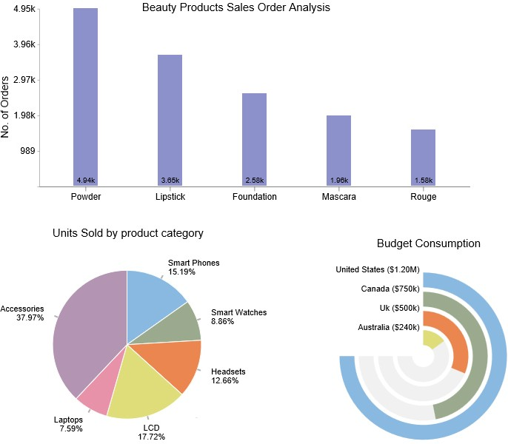
EDA: Graphical Technique
Graphical techniques in Exploratory Data Analysis (EDA) involve creating visual representations of data to uncover patterns, trends, and relationships.
Source :
https://ppcexpo.com/blog/wp-content/uploads/2022/01/exploratory-data-analysis-1.jpg
Notes:
Graphical Techniques:
Graphical techniques involve visual representations of the data, making it easier to detect patterns, trends, and outliers.
Histograms: Histograms display the frequency distribution of a single numerical variable. They help us understand the shape and spread of the data.
Box Plots: Box plots summarize the distribution of a variable and highlight outliers. They show the median, quartiles, and potential outliers in the data.
Scatter Plots: Scatter plots visualize the relationship between two numerical variables. They are useful for detecting correlations, clusters, and outliers.
Bar Charts: Bar charts are used to compare the frequency or count of categorical data. They provide a clear visual comparison between different categories.
Heatmaps: Heatmaps visualize the correlation matrix or other metrics across variables using color gradients. They are effective for showing relationships and patterns between multiple variables.
Pair Plots: Pair plots (or scatterplot matrices) display scatter plots for all pairs of numerical variables in a dataset. They help visualize relationships and interactions between variables.
Line Graphs: Line graphs are used to visualize trends over time or ordered data points. They are particularly useful for time series analysis.
Violin Plots: Violin plots combine the features of box plots and density plots, showing the distribution and probability density of the data across different categories.
Density Plots: Density plots smooth the data distribution using a kernel density estimate, providing a continuous probability distribution visualization.
Q-Q Plots: Quantile-Quantile (Q-Q) plots compare the quantiles of the data distribution to a theoretical distribution (e.g., normal distribution) to assess whether the data follows the expected distribution.
Conclusion:
Both quantitative and graphical techniques are essential components of EDA. Quantitative techniques provide precise numerical summaries and statistical tests, while graphical techniques offer intuitive visual insights into the data. Together, they form a comprehensive approach to exploring and understanding data, setting the stage for more advanced analysis and modeling.

Slide 21

NumPy
NumPy is an open-source Python library used for working with arrays.
NumPy stands for Numerical Python.
The NumPy array is a data structure that efficiently stores and accesses multidimensional arrays.
NumPy is a Python library and is written partially in Python, but most of the parts that require fast computation are written in C or C++.
Source :
https://en.wikipedia.org/wiki/NumPy
Notes:
"Now, let's talk about NumPy, an essential tool for data analysis and scientific computing in Python.
Introduction to NumPy: NumPy is an open-source Python library widely used for working with arrays. It is a fundamental package for numerical computing in Python, providing support for large, multi-dimensional arrays and matrices, along with a collection of mathematical functions to operate on these arrays efficiently.
What NumPy Stands For: NumPy stands for 'Numerical Python'. It is designed to handle numerical data efficiently and is a cornerstone of the scientific Python ecosystem.
NumPy Arrays: The core of NumPy is the array object, known as ndarray. The NumPy array is a powerful data structure that efficiently stores and accesses multidimensional arrays. Unlike Python's built-in lists, NumPy arrays are more compact, faster, and can handle large datasets more efficiently.
Efficiency of NumPy: NumPy achieves its high performance through several mechanisms:
Optimized C and C++ Code: Although NumPy is a Python library, it is written partially in Python, but most of the parts that require fast computation are written in C or C++. This allows NumPy to perform operations much faster than pure Python.
Vectorization: NumPy takes advantage of vectorized operations, which apply a function to an entire array, element-wise, without the need for explicit loops. This not only makes the code more concise and readable but also significantly speeds up computation.
Conclusion:
In summary, NumPy is an indispensable tool for anyone working with numerical data in Python. Its ability to handle large datasets efficiently, combined with its powerful array operations, makes it a go-to library for data scientists, engineers, and researchers. Understanding and utilizing NumPy is a crucial skill in the field of data analysis and scientific computing.

Slide 22


Lab Activity: Class Work
Lab 16: Implementing Numpy Concepts in Python
Solution: GitHub Link
Notes:
Lab16: Implementing Numpy Concepts in Python
Solution: GitHub Link

Slide 23
Self Practice-1
Self Practice 6: Numpy Self-practice
Solution: GitHub Link
Notes:
Self Practice 7: Numpy Self-practice
Solution: GitHub Link

Slide 24
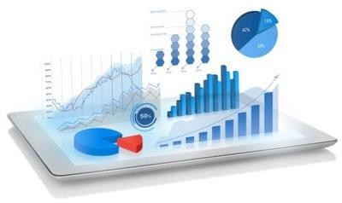
What is Data Visualization?
Data visualization deals with a visual representation of data and is part of data analysis. It is the process of translating data into a chart, graph, or other visual components.
Source :
https://www.techfunnel.com/wp-content/uploads/2020/10/data-visualization.png
Notes:
Today, we're diving into the crucial realm of data visualization—a powerful tool in data analysis that transforms complex datasets into clear, understandable visuals.
Definition and Purpose: Data visualization involves the visual representation of data, translating numbers and statistics into charts, graphs, and other visual components. Its primary purpose is to make data more accessible, understandable, and actionable. By presenting data visually, patterns, trends, and relationships can be quickly identified, enabling more informed decision-making.
Types of Visualizations: There are various types of visualizations suited for different data and insights:
Charts: Such as bar charts, line charts, pie charts, and histograms, which represent data points and their relationships.
Graphs: Like scatter plots, network graphs, and tree diagrams, which show connections and dependencies.
Maps: Geographical representations that visualize data spatially, such as heatmaps or choropleth maps.
Dashboards: Interactive displays that combine multiple visualizations to provide a comprehensive view of data trends and metrics.

Slide 25


Plotting and Visualization
Data visualization packages and tools are required to provide an accessible way to analyse massive amounts of information and understand trends and patterns in data.
Notes:
Today, we will discuss the significance of plotting and visualization in data analysis. Data visualization packages and tools are essential for transforming large datasets into comprehensible visual formats, making it easier to identify trends, patterns, and insights.
Importance of Data Visualization: Data visualization tools and packages play a crucial role in making data analysis accessible. They allow us to handle and interpret massive amounts of information efficiently. By converting raw data into visual elements like charts, graphs, and maps, we can quickly grasp complex concepts and identify underlying trends and patterns that might not be evident from raw data alone.
Enhancing Understanding and Insight: Visualizations help in summarizing data concisely and clearly. They provide a visual context that enhances our understanding of the data. For instance, a line chart can reveal trends over time, a bar chart can compare different categories, and a heatmap can show data density. These visuals facilitate quicker and more effective decision-making by highlighting key insights and relationships within the data.
Types of Visualizations: Different types of visualizations serve various purposes, depending on the nature of the data and the insights we seek:
Charts: Bar charts, line charts, and pie charts are excellent for showing numerical comparisons and trends.
Graphs: Scatter plots and network graphs are useful for visualizing relationships and correlations between variables.
Maps: Geographic visualizations such as heatmaps and choropleth maps are ideal for spatial data analysis.
Dashboards: Combining multiple visualizations into interactive dashboards provides a comprehensive view of key metrics and trends.

Slide 26

Matplotlib
Matplotlib is one of the most popular Python packages used for data visualization. It is a cross-
platform library for making 2D plots from data in arrays.
Notes:
Now, let's focus on one of the most popular Python packages for data visualization: Matplotlib.
Introduction to Matplotlib: Matplotlib is a widely-used Python library for creating static, animated, and interactive visualizations. It is particularly known for its ability to produce high-quality 2D plots and is a foundational tool in the data science and scientific computing community.
Cross-Platform Library: One of the key strengths of Matplotlib is its cross-platform compatibility. This means that it can be used on various operating systems such as Windows, macOS, and Linux, making it a versatile tool for developers and data scientists working in different environments.
2D Plotting Capabilities: Matplotlib excels at creating 2D plots from data stored in arrays. Some common types of plots you can create with Matplotlib include:
Line Plots: Useful for visualizing trends over time or continuous data.
Bar Charts: Ideal for comparing different categories or groups.
Histograms: Great for showing the distribution of a dataset.
Scatter Plots: Used to identify relationships and correlations between two variables.
Pie Charts: Effective for showing proportions and percentages of a whole.
Heatmaps: Useful for visualizing data density and correlations in matrix form.
Customization and Flexibility: Matplotlib offers extensive customization options, allowing users to fine-tune every aspect of their plots, including colors, labels, line styles, and more. This flexibility ensures that the visualizations can be tailored to specific needs and presentation styles.
Integration with Other Libraries: Matplotlib integrates seamlessly with other Python libraries such as NumPy, Pandas, and Seaborn, enhancing its functionality and enabling more sophisticated data analysis and visualization workflows. For example, you can use Pandas to manage your data, NumPy for numerical operations, and Matplotlib to visualize the results.
Ease of Use: Despite its powerful capabilities, Matplotlib is relatively easy to learn and use. It provides a simple interface for creating basic plots, making it accessible for beginners, while also offering advanced features for more experienced users.
Conclusion:
In summary, Matplotlib is a cornerstone of data visualization in Python. Its ability to create high-quality 2D plots, combined with extensive customization options and cross-platform compatibility, makes it an indispensable tool for anyone looking to visualize data effectively. By mastering Matplotlib, you can create compelling visual narratives that help uncover insights and communicate your findings clearly."

Slide 27
Lab Activity: Class Work
Lab 17: Type Your Act Practicing Matplotlib
Notes:
Lab 17: Type Your Act Practicing Matplotlib
Solution: GitHub Link

Slide 28

Seaborn
Seaborn is a Python data visualization library based on matplotlib. It provides a high-level interface
for drawing attractive and informative statistical graphics.
Notes:
Let's explore Seaborn, a powerful Python data visualization library built on top of Matplotlib. Seaborn simplifies creating attractive and informative statistical graphics with its high-level interface, allowing complex visualizations with minimal code. It supports various plot types like relational plots, categorical plots, distribution plots, and matrix plots. Seaborn integrates seamlessly with Pandas, facilitating easy plotting from DataFrames. It offers extensive customization options for creating polished visualizations and includes tools for statistical estimation, enhancing plot interpretability. Mastering Seaborn will greatly improve your ability to effectively communicate data insights.

Slide 29
Lab Activity: Class Work
Lab 18: Practicing Seaborn
Notes:
Lab21: Practicing Seaborn
Solution: GitHub Link

Slide 30
Self Practice-2
Self Practice 7: Self Practicing Matplotlib, and Seaborn
Notes:
Solution: GitHub Link

Slide 31

Pandas
Pandas is a Python library used for working with data sets (csv, json..,etc).
It has functions for
  and manipulating data.
The name "Pandas" has a reference to both "Panel Data", and "Python Data Analysis" and was created by Wes McKinney in 2008.
Analyzing
Cleaning
Exploring
Source :
https://en.wikipedia.org/wiki/Pandas_%28software%29
Notes:
Pandas is a fundamental Python library for working with datasets like CSV, JSON, and Excel files. It provides robust functions for analyzing, cleaning, exploring, and manipulating data. The name 'Pandas' is derived from 'Panel Data' and 'Python Data Analysis,' reflecting its core purpose. Key data structures include Series, a one-dimensional array, and DataFrame, a two-dimensional table. Pandas excels in data manipulation tasks like indexing, merging, grouping, and pivoting. Its seamless integration with libraries like NumPy, Matplotlib, and Seaborn makes it a cornerstone of the Python data science ecosystem.

Slide 32
Lab Activity: Class Work
Lab 19: Practicing Pandas
Notes:
Lab22: Practicing Pandas
Solution: GitHub Link

Slide 33
Self Practice-3
Self Practice 8: Pandas
Notes:
Self Practice9: Self Practicing Pandas
Solution: GitHub Link

Slide 34

Story telling with Data
Storytelling is the art of conveying a message or information through a narrative.
It has been a fundamental part of human culture for thousands of years, serving as a means to entertain, educate, preserve culture, and instill values.
In the context of data, storytelling involves weaving data points into a narrative that communicates insights and compels the audience to take action.
Notes:
Storytelling is the art of conveying a message or information through a narrative.
It has been a fundamental part of human culture for thousands of years, serving as a means to entertain, educate, preserve culture, and instill values.
In the context of data, storytelling involves weaving data points into a narrative that communicates insights and compels the audience to take action.
Characteristics of a Good Story
A good story typically has the following characteristics:
Clarity: The narrative is easy to understand.
Engagement: The story captivates the audience's attention.
Relevance: The story is pertinent to the audience's interests or needs.
Structure: It has a clear beginning, middle, and end.
Emotion: It evokes emotional responses from the audience.
Visuals: Effective use of visuals to support and enhance the narrative.

Slide 35
How to Create Data Stories?
Understand the Audience
Identify Key Messages
Collect and Analyze Data
Create a Narrative
Design Visuals
Refine and Practice
Notes:
How to Create Data Stories?
Creating data stories involves several steps:
Understand the Audience: Know who they are and what they care about.
Identify Key Messages: Determine the main points you want to communicate.
Collect and Analyze Data: Gather relevant data and analyze it to find insights.
Create a Narrative: Build a storyline around the insights.
Design Visuals: Use charts, graphs, and other visuals to support the story.
Refine and Practice: Polish the narrative and practice delivering it.

Slide 36
Lab Activity: Class Work
Lab 20: End-to-End Story Telling project on real-world dataset
Notes:
Lab23: End-to-End Story Telling project on real-world dataset
Solution: GitHub Link

Slide 37

Summary
You will learn in this Chapter:
We studied about the meaning of exploratory data analysis.
We have understood the necessity of exploratory data analysis on a new dataset.
We have used different types of tools and techniques of EDA
We have understood how to use pandas and sleep on libraries for exploratory data analysis.
Notes:
Exploratory Data Analysis (EDA) refers to the process of examining datasets to uncover patterns, trends, and relationships. It serves as a crucial first step in understanding data before applying more complex analysis or modeling techniques.
We have explored:
Definition of EDA: EDA involves analyzing data to summarize its main characteristics using visualizations and statistical techniques.
Importance of EDA: EDA is essential for understanding the structure of a new dataset, identifying outliers, handling missing values, and preparing data for modeling.
Tools and Techniques: We have utilized various tools such as Pandas for data manipulation and analysis, and Seaborn for creating informative visualizations.
Application of Libraries: Pandas facilitated data cleaning, transformation, and initial analysis, while Seaborn provided advanced plotting capabilities for visualizing relationships and distributions in the data.
In conclusion, mastering EDA enables data scientists to derive meaningful insights, validate assumptions, and prepare data for further analysis or modeling tasks effectively.

Slide 38
Reference
Exploratory Data Analysis (EDA) - Types and Tools - GeeksforGeeks
Exploratory Data Analysis (EDA): Types, Tools, Process (knowledgehut.com)
Exploratory Data Analysis (nist.gov)
https://towardsdatascience.com/web-scraping-basics-82f8b5acd45c
https://www.analyticsvidhya.com/blog/2021/06/web-scraping-with-python-beautifulsoup-library/

Slide 39

?
QUIZ

Slide 40

Quiz
?
1. What is the primary goal of Exploratory Data Analysis (EDA)?
Building predictive models
Data visualization
Extracting insights from data
Data cleaning
Answer: C
Extracting insights from data
Notes:
Question 1: What is the primary goal of Exploratory Data Analysis (EDA)?
Building predictive models
Data visualization
Extracting insights from data
Data cleaning
Answer: c) Extracting insights from data

Slide 41
Quiz
?
2. Which of the following is NOT a common step in EDA?
Summary statistics
Data transformation
Hypothesis testing
Implementing predictive models
Answer: D
Implementing predictive models
Notes:
Question 2: Which of the following is NOT a common step in EDA?
Summary statistics
Data transformation
Hypothesis testing
Implementing predictive models
Answer: d) Implementing predictive models

Slide 42
Quiz
?
3. What type of visualization is useful for displaying the distribution of categorical data?
Scatter plot
Line plot
Histogram
Box plot
Answer: C
Histogram
Notes:
Question 3: What type of visualization is useful for displaying the distribution of categorical data?
Scatter plot
Line plot
Histogram
Box plot
Answer: c) Histogram

Slide 43
Quiz
?
4. Which EDA technique is useful for identifying outliers in a dataset?
Correlation analysis
Time series decomposition
Box plot
Hypothesis testing
Answer: C
Box plot
Notes:
Question 4: Which EDA technique is useful for identifying outliers in a dataset?
Correlation analysis
Time series decomposition
Box plot
Hypothesis testing

Slide 44
Quiz
?
5. Which library is commonly used for creating interactive and informative statistical graphics in EDA?
Matplotlib
Seaborn
Numpy
Scikit-learn
Answer: B
Seaborn
Notes:
Question 5: Which library is commonly used for creating interactive and informative statistical
graphics in EDA?
Matplotlib
Seaborn
Numpy
Scikit-learn

Slide 45
Thank You
Notes:
Thank You

